Slide 1
MLB Betting Analysis
Yusif Affara, Chase Cardon, Andrew Fish, Marcel Hujanen, Luke Ponticello

Slide 2
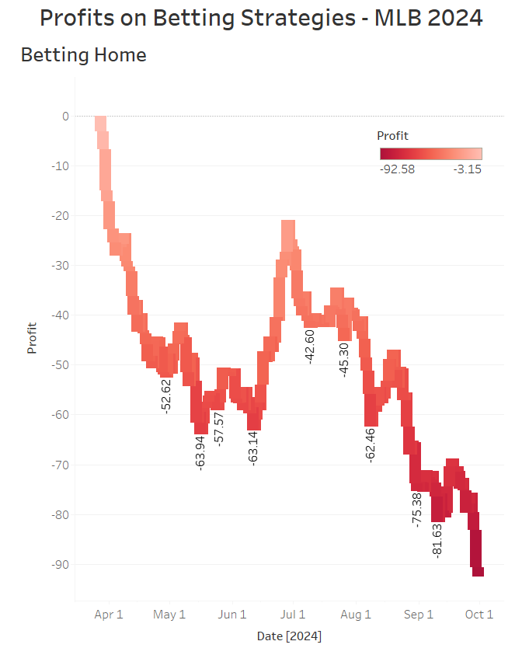
Home
Strategy | Returns | Profit | Profit Rate
Home | $2335.42 | -$92.58 | -3.81%
The returns and profits were calculated using a $1 bet size
The returns can be deceiving. While appears to be making a lot of money it is cancelled out by betting every game
Looking at the waterfall chart only on period with large profits. Started on June 1st and ending on July 1st
Overall, wouldn’t recommend employing this strategy on every game
Home Team winning 52.18%*** further investigation could find a profitable strategy using the Home Team
Average odds show Home Team is typically favored (-37.15)
Receiving about 61% of the bets on average

Slide 3
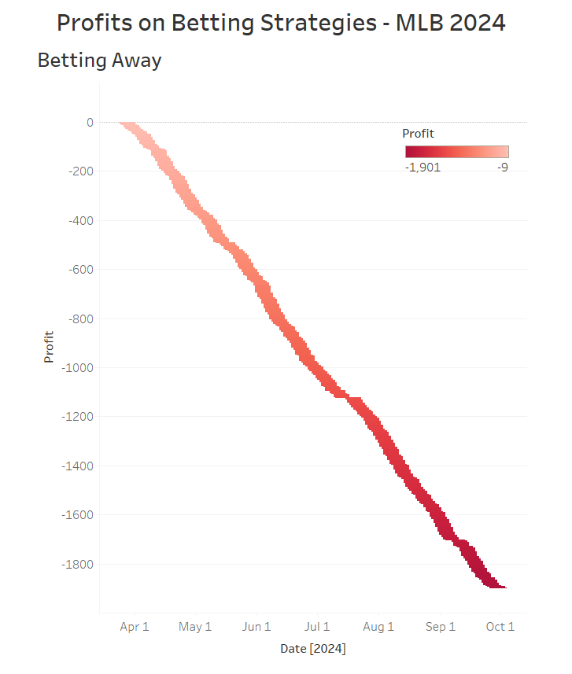
Away
Strategy | Returns | Profit | Profit Rate
Away | $530.84 | -$1897.16 | -78.14%
Worse than Home
Lower Returns, Profit, and Profit Rate
Looking at waterfall chart it is all down no peaks
Do not employ this strategy
Average odds show Away Team typically underdog (48.7)
Away Team wins less often as well 47.69%***
Receiving about 39% of the bets on average

Slide 4
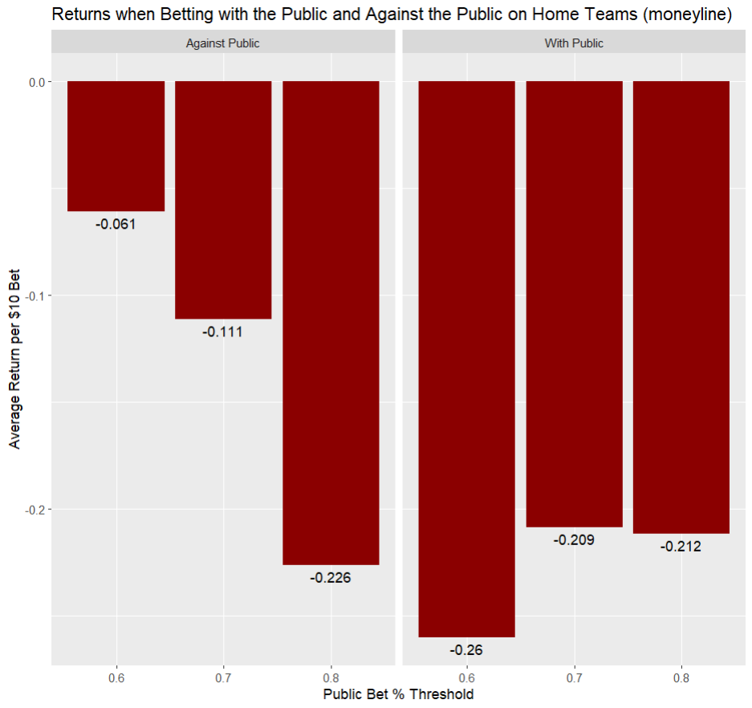
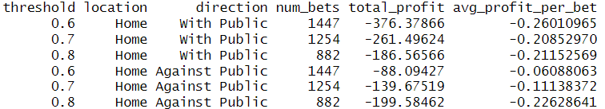
Public Betting Strategies on Home Teams
Tested data using a consistent bet of $10
Thresholds at 60%, 70%, and 80%
Betting against the public, as well as betting with the public on home teams resulted in a loss at all thresholds
Suggesting the market is highly efficient

Slide 5
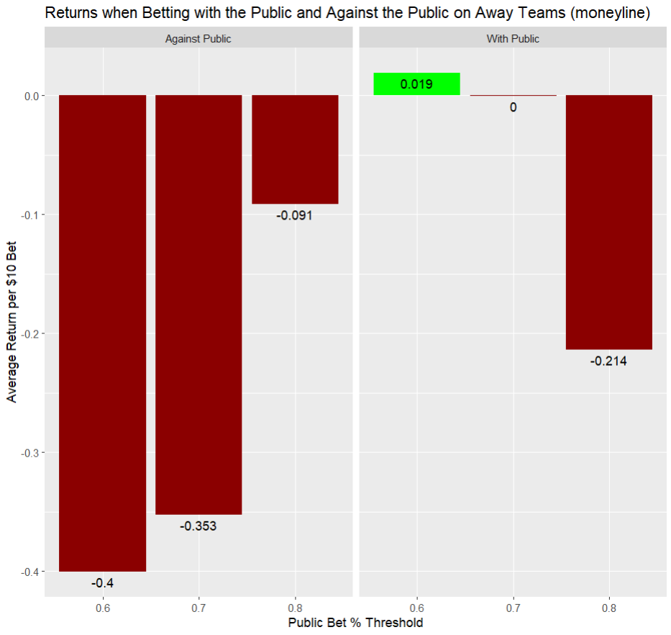
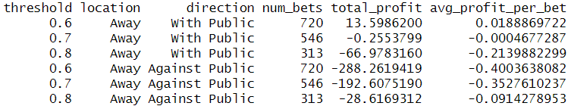
Public Betting Strategies on Away Teams
Betting against the public on away teams resulted in the largest losses
Betting on away teams that received 60%+ of public bets resulted in a profit, but of very little value. (2 cents per $10)

Slide 6
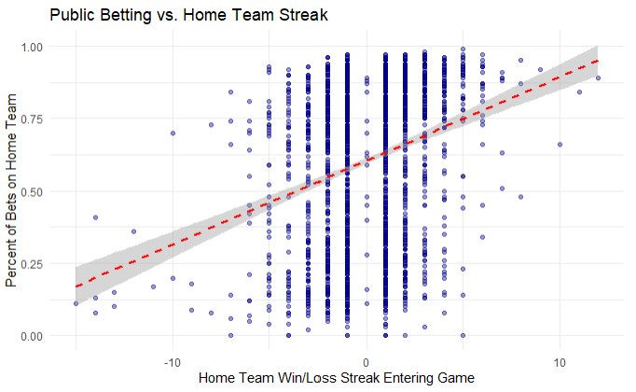
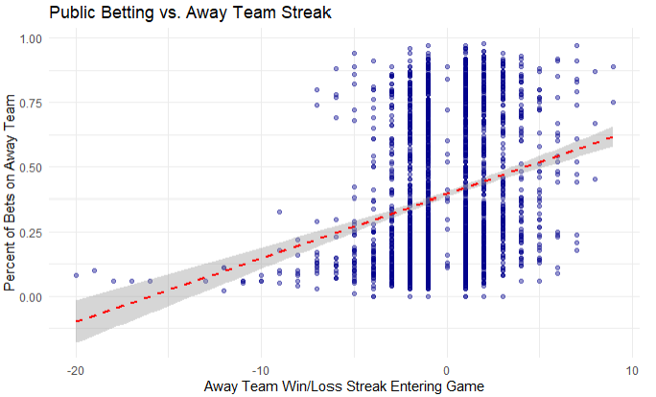
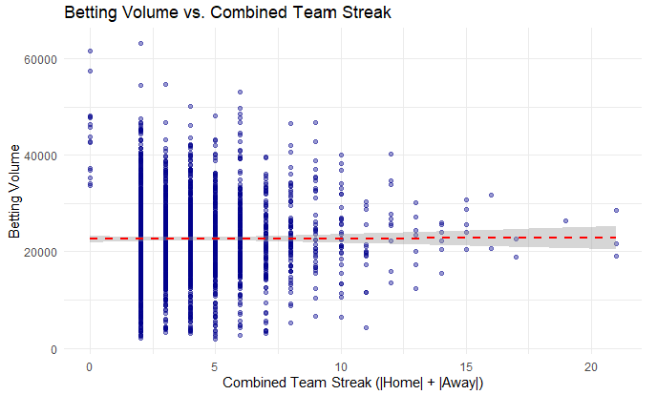
Investigating the Hot Hand Hypothesis in MLB Betting
Are Bettors, Sportsbooks, and Team Performance Influenced by Win Streaks?
Model 1: The % of a game's bets on the Home Team explained by HomeStreak
  lm(pct_bet_home ~ HomeStreak + Home_bestodds + Volume)
  HomeStreak coef: +0.021 → Each additional win increases % bets on the team by ~2.1 percentage points (p < 0.001)
Model 2: The % of a game's bets on the Away Team explained by AwayStreak
  lm(pct_bet_away ~ AwayStreak + Away_bestodds + Volume)
  AwayStreak coef: +0.016 → Similar bias toward hot away teams (p < 0.001)
Conclusion: Bettors favor teams on winning streaks by percentage.
Model 3: The betting volume explained by ComboStreak (abs(HomeStreak) + abs(AwayStreak))
  lm(Volume ~ ComboStreak + Home_bestodds + Total, data = mlb_data)
  ComboStreak coef: 3.4 (p = 0.96)→ With a P value so incredibly high, we cannot say that the combined streaks of two teams has any affect at all on volume of bets on a game.
Conclusion: While bettors do chase individual hot teams, games featuring two streaking teams (or one really streaky team) have no impact on the volume of bets on the game.

Slide 7
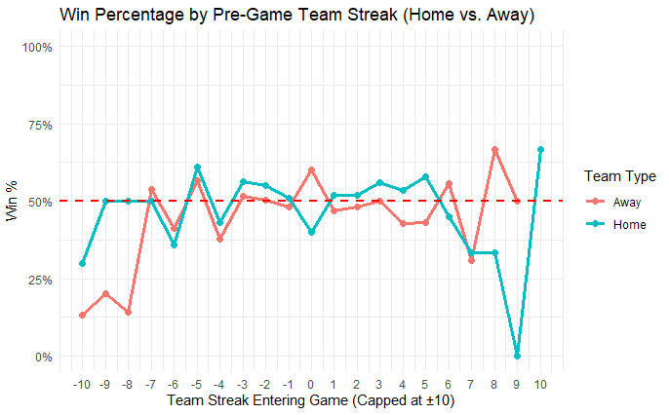
Can the Hot Hand Fallacy Yield Betting Profitability?
Model 4: HomeWin as explained by HomeStreak
  glm(HomeWin ~ HomeStreak + Home_bestodds, family = binomial)
  HomeStreak coef: -0.01853 (p = .279) → Not significant — Team streak doesn't predict win probability
Strategy: Exploit the Hot Hand Fallacy by betting against teams on 2+ game win streaks
  Fading hot home teams yields a positive return:
    Avg. profit: $0.0296 per $1 bet (~2.96% return)
    Total profit over 649 games: $18.42
  Fading hot away teams yields a positive return:
    Avg. profit: $0.002 per $1 bet (~ 0.2% return)
    Total profit over games: $1.16
Conclusion: The market slightly overvalues hot home teams, creating a small, consistent profit opportunity when betting against them, even if the belief in the hot hand isn’t backed by performance data. Fading away teams on a 2 game win streak has a very small profit, virtually a push.

Slide 8
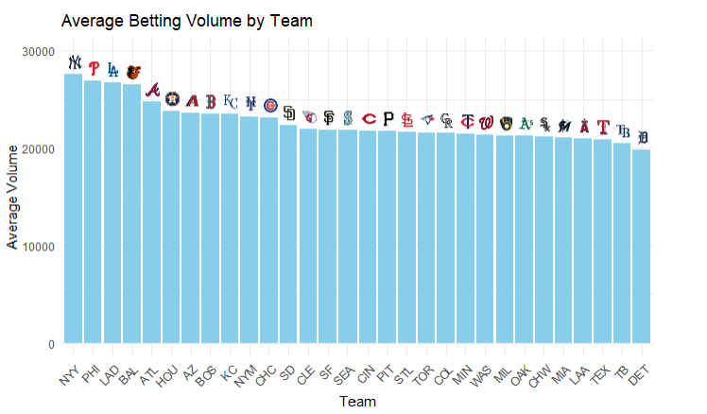
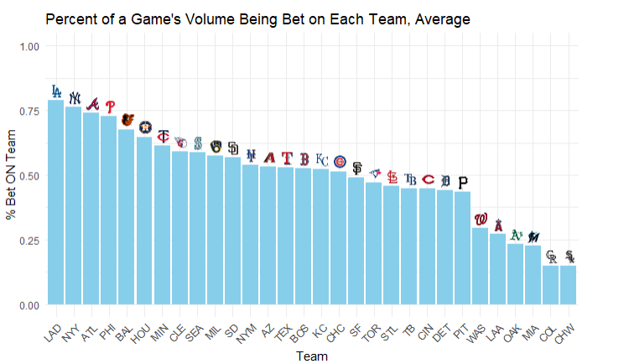
Public Bias Toward Marquee MLB Teams
The charts reveal a clear pattern in bettor behavior: fans are significantly more likely to bet on marquee teams with strong brand recognition or recent success. Notably, teams like the Yankees, Dodgers, Phillies, Braves, Orioles and Astros appear at or near the top in both average betting volume and the percentage of bets placed on them. This suggests that public bettors are heavily drawn to high-profile franchises, whether due to their large fan bases, consistent performance, or media exposure. The data implies a bias toward familiar and popular teams, even when betting objectively might call for a more balanced view across the league.

Slide 9
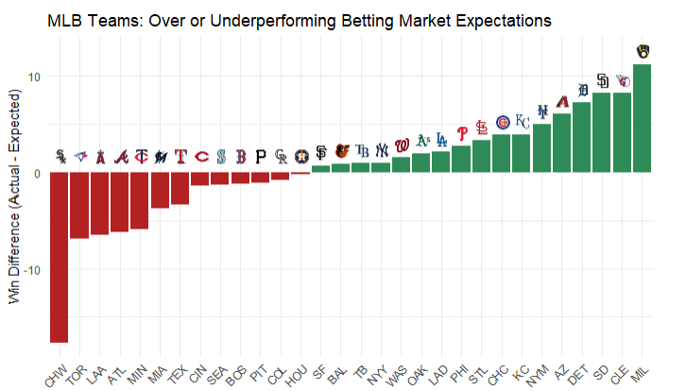
Teams that Outperformed Sportsbook Expectations
We converted each team's betting odds into implied win probabilities and summed them across the season to estimate how many games sportsbooks expected each team to win. Comparing these totals to actual win records revealed which teams over- or underperformed expectations. The Brewers, Guardians, Padres and Tigers notably exceeded their projected wins, while the White Sox, Blue Jays, and Angels fell well short, underperforming relative to the betting market. This highlights the gap between market predictions and on-field results.

